Slide 1
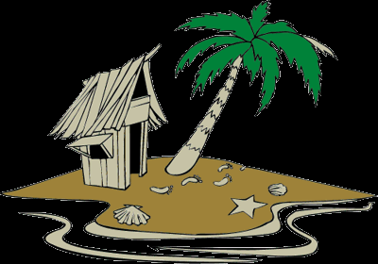
Genetic Variation & the Founder Effect

Slide 2
Genetic Variation & the Founder Effect
Starter
How can genetic diversity be increased?
How can genetic diversity be decreased?
List as many ways as you can think of

Slide 3
Learning Objectives
Understand what is meant by the ‘Founder effect’ and how it results in a loss of genetic diversity
Explain how genetic diversity is effected as a result of population bottlenecks
Look at selective breeding as an artificial bottlenecking

Slide 4
Key terms
Genetic diversity
Allele frequency

Slide 5
Key terms
Genetic diversity – genetic differences between individuals within a population (in terms of alleles)
Allele frequency – how often a particular allele occurs within a population.

Slide 6
The Founder effect
Island
The Mainland

Slide 7
The Founder effect
Population
Island
The Mainland

Slide 8
The Founder effect
A few individuals colonise a new isolated area
The Mainland

Slide 9
There may be a higher frequency of one allele in the founder population just by chance
This allele needn’t have been very common in the original population

Slide 10
The island population grows
Island

Slide 11
…after a few generations
The green allele may be lost completely if individuals fail to leave offspring carrying it
Island

Slide 12
…after a few generations
The green allele may be lost completely if individuals fail to leave offspring carrying it
Island

Slide 13
…after a few generations
Mutations may occur creating new alleles
Island

Slide 14
…after a few generations
The new allele becomes more common
Island

Slide 15
The 2 populations now look very different!
Island
The Mainland

Slide 16
The Founder Effect
Occasionally a small group of individuals may migrate away or become isolated from a population
The ‘founding’ population is only made up of a small number of individuals. Inbreeding may be a problem if individuals are closely related
It may have a non-representing sample of alleles from the parent population
The colonizing population may evolve quite differently from the original population, especially if the environment is different
Certain alleles may go missing all together as a consequence, resulting in a loss of genetic diversity

Slide 17
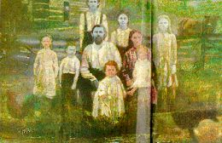
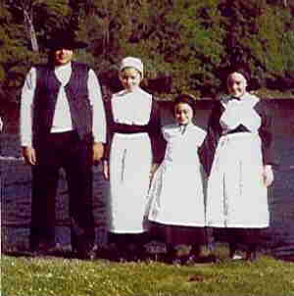
Some examples of the founder effect in action…
The Amish people, Pennsylvania
The Fugates of Kentucky

Slide 18
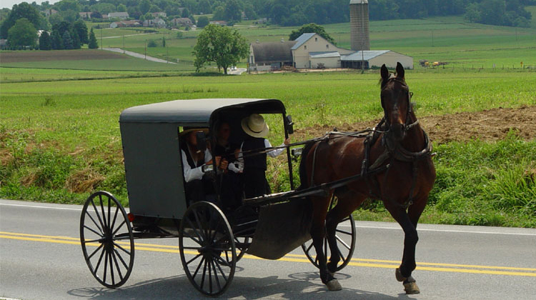
The Amish People
200 in founding population
Within community marriages
Recessive conditions are common
Haemophilia
Dwarfism (1/14 carry the gene)
Still births/infant deaths
Physical deformaties

Slide 19
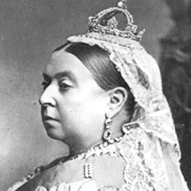
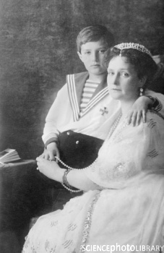
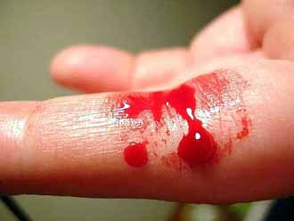
‘The Royal Disease’
Haemophilia
The Tsars

Slide 20
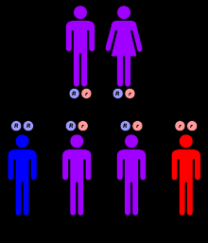
The Fugates
Small founding population
Mountain communities
2 of the founders were carriers
of a recessive allele
Blue skin!

Slide 21
Population bottlenecks
Ecological events may reduce population sizes dramatically e.g. earthquakes, floods, fires.
Disasters that are unselective .
Small surviving populations are unlikely to be representative of the original population.
By chance alleles may be overrepresented among survivors, some may be eliminated completely.

Slide 22
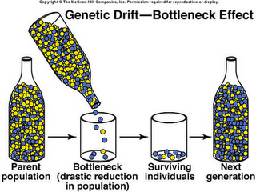

Slide 23
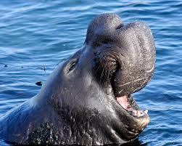
Northern Elephant Seals
Hunted close to extinction
Individuals on islands survived
Reduced genetic diversity compared with southern elephant seals

Slide 24
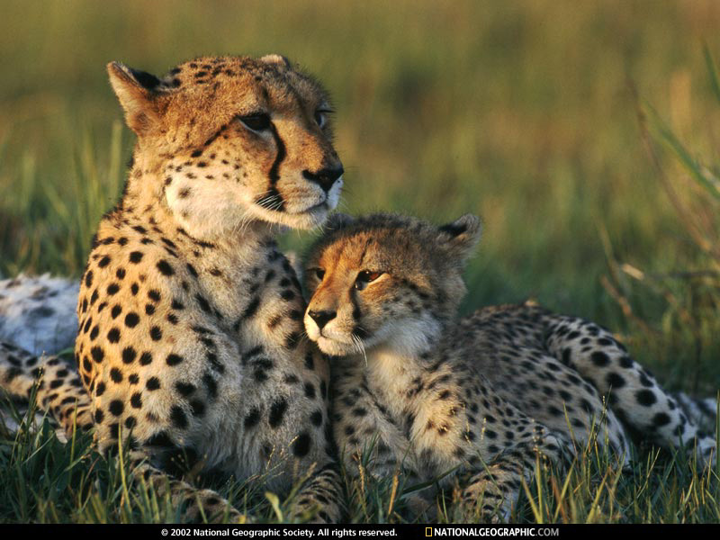
Cheetahs
10,000 years ago all but 1 species had died out
Severely threatened
Very low genetic diversity resulting in poor sperm quality among males
Females forced to breed with close relatives
Inbreeding generally decreases
the fitness of a population
(an inbreeding depression)

Slide 25
Skittles bottleneck game
Different coloured skittles represent different alleles.
Count the number of individuals in the population in your bottle, calculate the frequency of each colour allele (%).
Mix your sample of alleles in the bottle.
Let 5 alleles through the bottleneck after a disaster causing a crash in population numbers.
Record the colours & numbers of these 5 alleles.
When each individual in this generation dies it can leave a maximum of 3 offspring (or 3 skittles of the same colour) unless you do not have enough of this particular colour, in which case the individual has failed to reproduce. Record the new allele frequencies.
Remove the original population from the bottle and put in the survivors.
Repeat the process of letting 5 individuals through a bottleneck, recording the allele frequencies, letting them reproduce if possible and recording the allele frequencies again.
Repeat instructions 3-7 for 10 disasters

Slide 26
Similarities and differences between the founder effect & bottlenecking

Slide 27
Similarities and differences between the founder effect & bottlenecking
Similarities | Differences
Both are followed by genetic drift which results in changes in allele frequencies | In Bottlenecks individuals are killed, reducing the choice of mates, in the founder effect individuals are ecologically separated
Initially genetic diversity is lost in both systems
Both involve a small number of individuals breeding with each other, both may involve inbreeding among close relatives
Both may result in a new population which carries alleles that are unlikely to be a true representation of the original group

